Slide 1



HEART DISEASE DIAGNOSIS ANALYSIS
DETAILED PROJECT REPORT
ABEEN BACKER PALLIYAL
iNeuron

Slide 2





PROJE CT D E T AILS
Project T i t l e | Heart Disease Diagnostic – Analysis
Technology | Business Intelligence
Domain | Healthcare
Project Difficulty level | Advanced
Programming Language Used | Python
Tools Used | Jupyter Notebook, MS-Excel, MS-Power BI
iNeuron

Slide 3
OBJECTIVE
▶ The goal of this project is to analyse the heart disease occurrence, based on a c ombination of features that describes the heart disease.
iNeuron

Slide 4



P R O B L E M S T A T E M E N T
▶ Health is real wealth - In the pandemic time we all realized the brute effects of covid-19 on all irrespective of any status. You are required to analyse this health and medical data for better future preparation.
▶ A dataset is formed by taking into consideration some of the
information of 303 individuals.
iNeuron

Slide 5
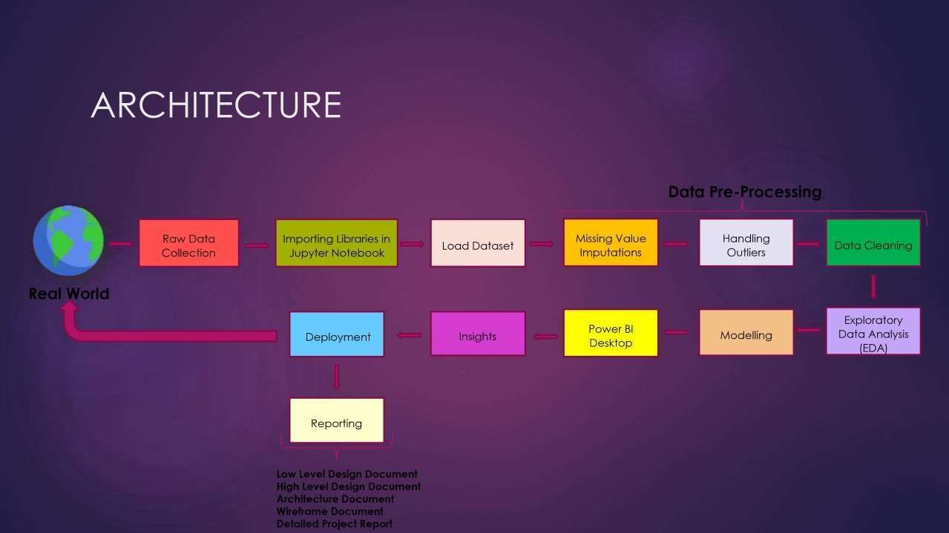

Slide 6
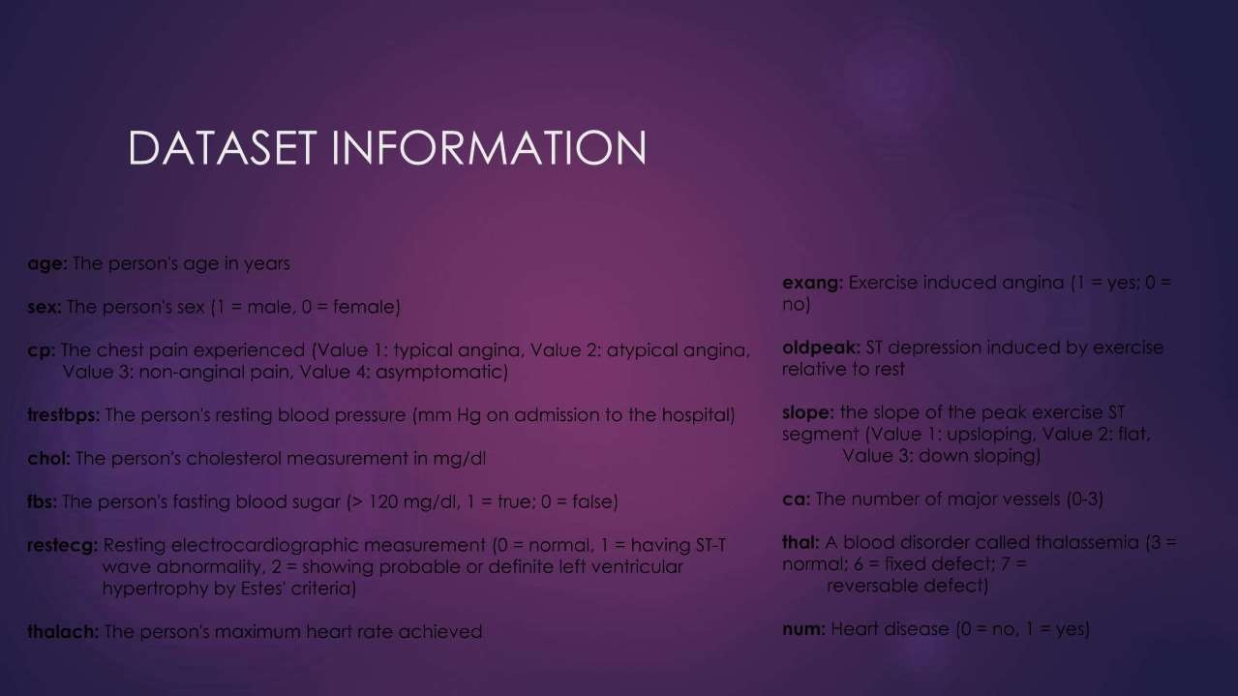

Slide 7
Age: Age is the most important risk factor in developing cardiovascular or heart diseases, with approximately a tripling of risk with each decade of life. Coronary fatty streaks can begin to form in adolescence. It is estimated that 82 percent of people who die of coronary heart disease are 65 and older. Simultaneously, the risk of stroke doubles every decade after age 55.
Sex: Men are at greater risk of heart disease than pre-menopausal women. Once past menopause, it has been argued that a woman's risk is similar to a man’s although more recent data from the WHO and UN disputes this. If a female has diabetes, she is more likely to develop heart disease than a male with diabetes.
Why These Parameters are Important?
Resting Blood Pressure: Over time, high blood pressure can damage arteries that feed your heart. High blood pressure that occurs with other conditions, such as obesity, high cholesterol or diabetes, increases your risk even more.
Fasting Blood Sugar: Not producing enough of a hormone secreted by your pancreas (insulin) or not responding to
insulin properly causes your body's blood sugar levels to rise, increasing your risk of heart attack.
Cholesterol: A high level of low-density lipoprotein (LDL) cholesterol (the "bad" cholesterol) is most likely to narrow arteries. A high level of triglycerides, a type of blood fat related to your diet, also ups your risk of heart attack. However, a high level of high-density lipoprotein (HDL) cholesterol (the "good" cholesterol) lowers your risk of heart attack.
Resting ECG: For people at low risk of cardiovascular disease, the USPSTF concludes with moderate certainty that the potential harms of screening with resting or exercise ECG equal or exceed the potential benefits. For people at intermediate to high risk, current evidence is insufficient to assess the balance of benefits and harms of screening.

Slide 8
Max heart rate achieved: The increase in the cardiovascular risk, associated with the acceleration of heart rate, was comparable to the increase in risk observed with high blood pressure. It has been shown that an increase in heart rate by 10 beats per minute was associated with an increase in the risk of cardiac death by at least 20%, and this increase in the risk is similar to the one observed with an increase in systolic blood pressure by 10 mm Hg.
ST Depression: In unstable coronary artery disease, ST-segment depression is associated with a 100% increase in the occurrence of three-vessel/left main disease and to an increased risk of subsequent cardiac events. In these patients an early invasive strategy substantially decreases death/myocardial infarction.

Slide 9
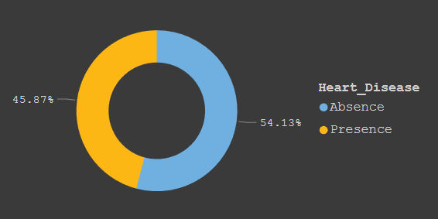
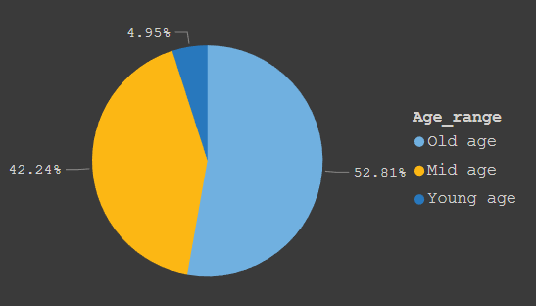

I N S I G H T S
What Kind of Population do we have?
45.87%People suffering from heart disease
We have more Old age people (>55)
i.e. 52.81% in our dataset.
from our Total population.

Slide 10
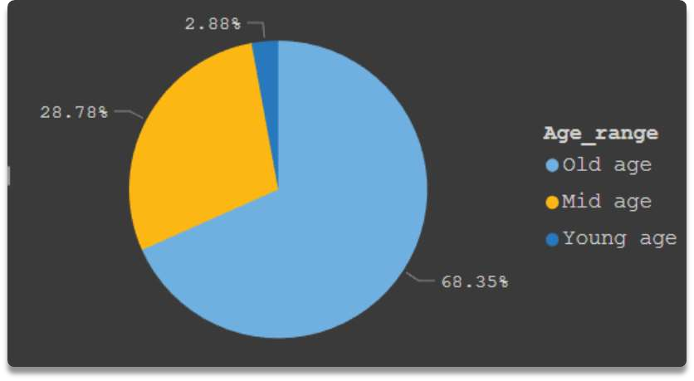

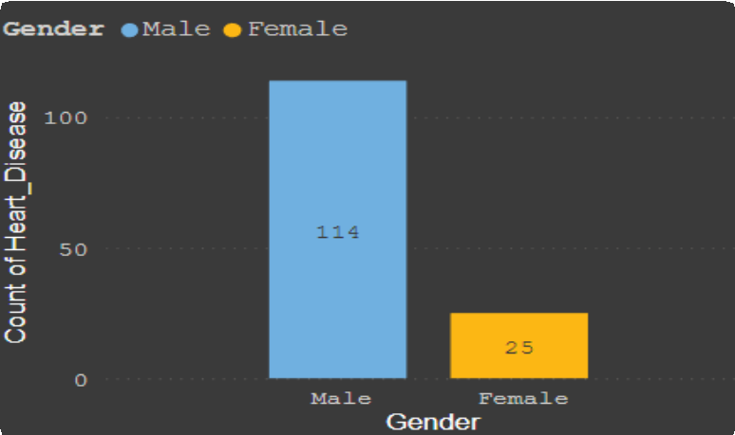
Who suffers from heart disease?
68.35 % people who belongs to elder age (>55)
Males are more affected by heart
disease than the females
are more prone to heart disease.

Slide 11
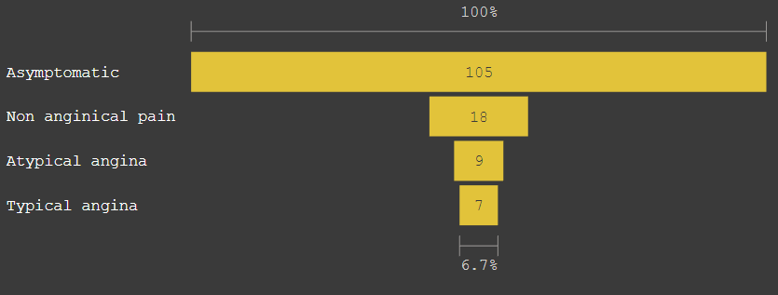
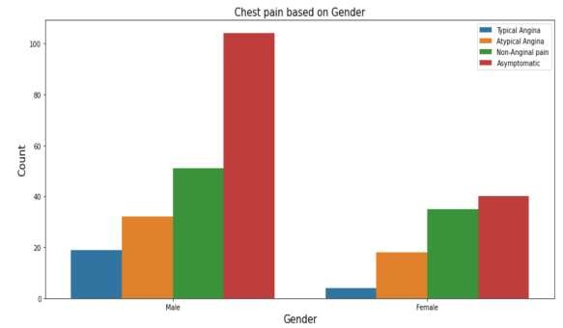
Chest pain experienced by Heart patients
It is very interesting to see that more heart
Both males and females have more
asymptomatic chest pain followed by
patients don’t have any symptoms of chest pain
(asymptomatic).
Atypical angina chest pain.

Slide 12
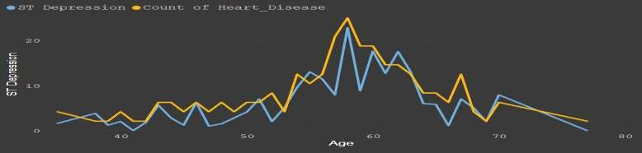
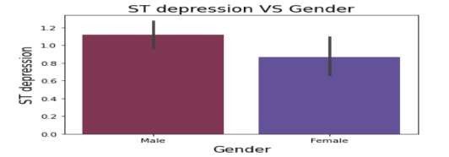
ST Depression and how it is related to Heart disease
ST depression refers to a finding on an electrocardiogram, wherein the trace in
the ST segment is abnormally low below the baseline.
We could see that ST Depression increases after the age 52-55 and reaches it’s highest at the age of 57-60 then decreases.
There is a positive correlation between ST Depression and Heart disease as ST depression increases then chances of Heart disease also
We could see that Males are more getting ST
depression than the Females.
increase.

Slide 13



Other Observations:
Avg of Max Heart rate of the patients who is having heart disease
(139.26mm/Hg) is less than those who don’t have Heart disease.
ECG Measurement is higher (163) in patients who have heart disease than who don’t have heart disease.
Average cholesterol is higher (251.47) in Heart patients
those who have heart disease than those who don’t have.

Slide 14
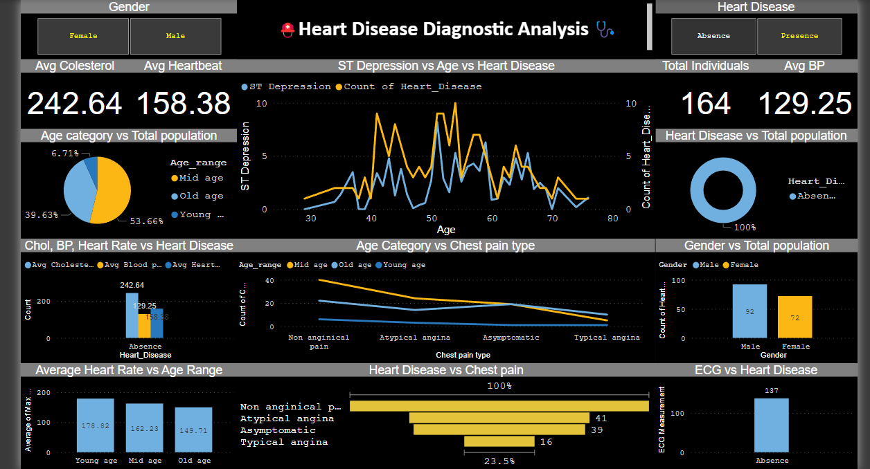

Slide 15

KEY PERFORMANCE INDICATOR
Age distribution based on Heart disease
Gender distribution based on Heart disease
ST depression and age based on Heart disease
Age category vs Chest pain type
Heart disease (Presence/Absence) in Total population
Chest pain type vs Heart disease
Cholesterol, Blood pressure, Heart rate based on Heart disease patients
ECG Measurement vs Heart disease

Slide 16
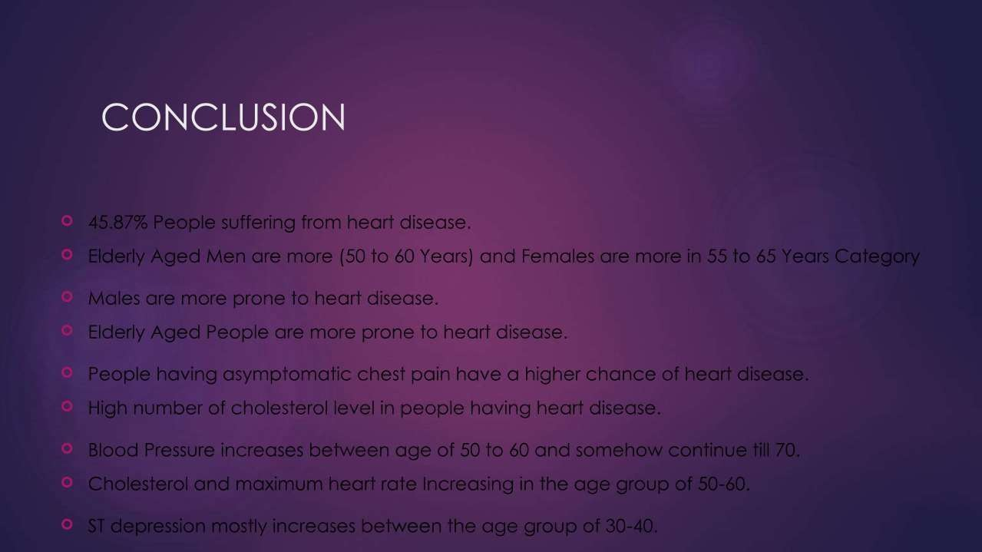

Slide 17


Slide 18






THANK YOU !

